Slide 1
Implementation of a Web Shopping Application
Gong Chen
Advisor: Tom Gendreau
Master of Software Engineering
Oral Presentation
Notes:
Hello everyone! my name is Gong Chen. My advisor is Tom Gendreau.
the title of my presentation is Implementation of a Web Shopping Application

Slide 2

Outline
Introduction
The Software Development Life Cycle Model
Requirements
Design
Implementation
Testing
Future Work
Demo
Notes:
Here is the outline of my presentation
Firstly i will briefly introduce my project and also talk about the life cycle model i used
And then i will describe the requirement, design, implementation, testing, and conclusions of my project
At last i will show the demo of my project.

Slide 3
Introduction
A Traditional Shopping Application Using a Relational Database
Reengineering the Project with a NoSQL Database
Notes:
In this section I will talk about the background and brief idea of my project. And give some introduction about NoSQL database and MongoDB as well.

Slide 4
Introduction
A Traditional Shopping Application Using a Relational Database
Reengineering the Project with a NoSQL Database
Notes:
In this section I will talk about the background and brief idea of my project. And give some introduction about NoSQL database and MongoDB as well.

Slide 5
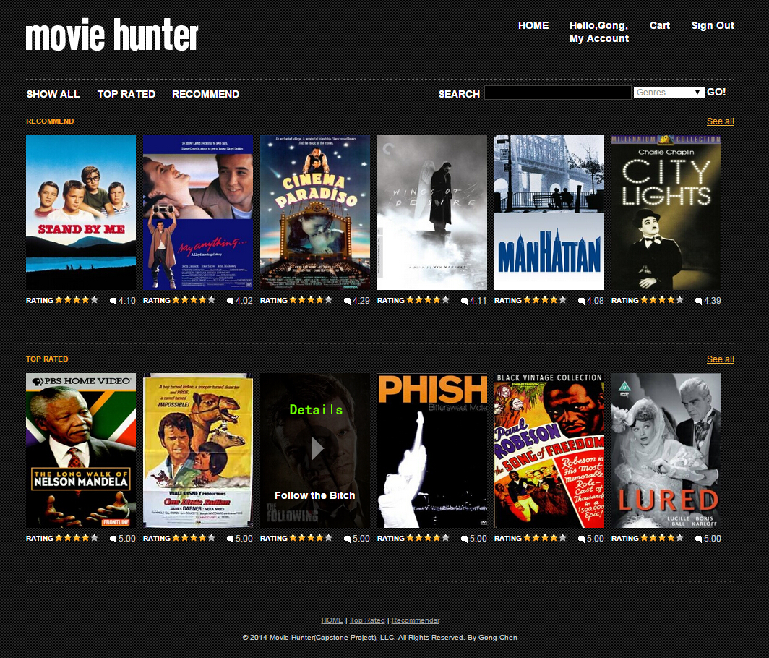
A Traditional
The object of the project is a web shopping application called Movie Hunter which is associated with a log management module and recommendation module.
Notes:
The object of the project is a web shopping application which is associated with a log management system and recommendation system.
The name of this web is Movie Hunter. The product sold in application is movies. Like all the other shopping application, Movie Hunter provides all the functionalities required, such as searching, browsing details of movies, adding movies to cart and so on.
What makes it special is the log management system and recommendation system.
Log management system is responsible for recording the activities of users.
The main function of recommendation system is to recommend movies to user based on his/her previous activities.
I will give more details of log management system and recommendation system later.

Slide 6
NoSQL & Mongo DB
NoSQL Database
A NoSQL database provides a mechanism for storage and retrieval of data that is modeled in means other than the tabular relations used in relational databases
Mongo DB
Mongo DB is a cross-platform document-oriented NoSQL database
Notes:
As I mentioned, this application will connection to both SQL and NoSQL databases.
The SQL I choose is MySQL.
The NoSQL I choose is MongoDB.
What is NoSQL database? Different from SQL databases, A NoSQL database provides a mechanism for storage and retrieval of data that is modeled in means other than the tabular relations used in relational databases. That means the tables or collections are isolated from each other. Their relations like one to many or many to many is undefined in NoSQL.
MongoDB is one most popular NoSQL database.

Slide 7
Mongo DB
Mongo DB Compared With MySQL
MySQL | Mongo DB
Tables | Collections
Rows | Documents
Columns | Key/value pairs
Joins | Joins not available.
Notes:
Here is the comparison of MySQL and Mongo DB.
As you know, the object of MySQL is table. In Mongo DB, they call it collection.
In MySQL each data is stored as a row of table. In Mongo DB, it is stored as a line of document.
The attribute of each row is columns in MySQL. While in Mongo DB, it’s key/values pairs. InMySQL, you have defined the type of columns, such as int, datatime, string and so on. In mongo you don’t need to define it. For example, if you store a datatime to a int field in MySQL, it will throw out an exception. However, in mongo, it is allowed.
There is no joins in MongoDB. Just like there is no relations in MongoDB

Slide 8
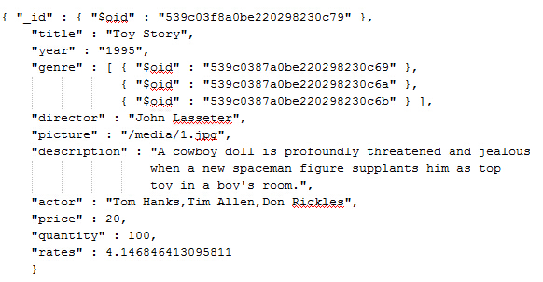
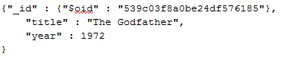
Mongo DB
An example for a document in Mongo DB
Notes:
Here is an example of document. This one is a record of a movies. The attributes of the movies are key/value pairs. It’s a like map. Title is mapped with “Toy Story”. Year is mapped with 1995. The type of attribute in mongo db is not defined.

Slide 9
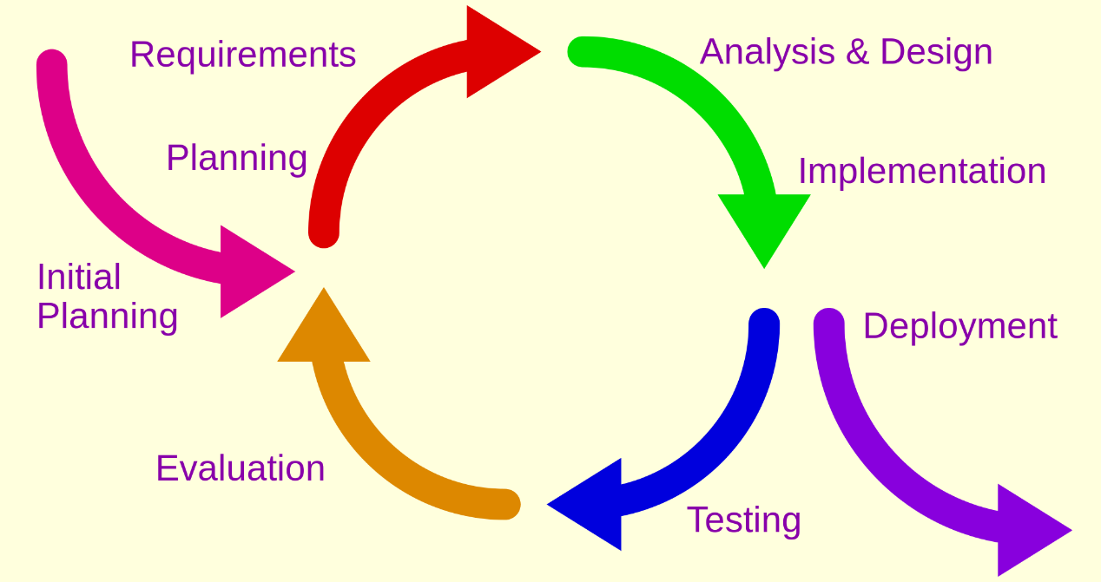
Life Cycle Model
Incremental Prototype
The incremental model is a method of software development where the models is designed, implemented and testing incrementally until the product is finished
Notes:
I choose Incremental prototype as a life cycle model for my project. The incremental model is a method of software development where the models is designed, implemented and testing incrementally until the product is finished.
There are a lot of new technology I used in this project such as Django, Scrapy, MongoDB and so on. The reason why I choose incremental prototype is the uncertainty of the learning process for those new technology.

Slide 10
Life Cycle Model
Incremental Prototype
Prototype 1: Design and implement customers’ functionalities based on MySQL
Prototype 2: Design and implement administrators’ functionalities based on MySQL
Prototype 3: Design and implement log management system and recommendation system based on MySQL
Prototype 4: Reengineering the project with NoSQL database

Slide 11
Requirements
User Description
User Cases
System Requirement
Notes:
In this section I will talk about the requirements of this project.

Slide 12
Requirements
User of System
Guest Customer
Registered Customer
Normal administrator
Super Administrator
Notes:
There are four kinds of users in this system.
They are Guest Customer
Registered Customer
Normal administrator
Super Administrator
There are some assumptions for users. For example, there is only one super administrator in the system. However, the number of normal administrator is more than one.

Slide 13
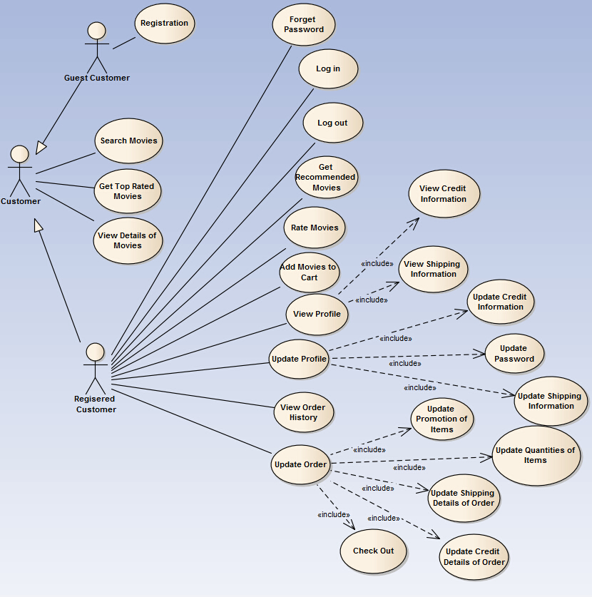
Requirements
User Cases of Customer
Notes:
There are 2 different type of customers. They are guest customer and registered customer. Different customer have different functionalities. As it’s shown in the diagram.

Slide 14
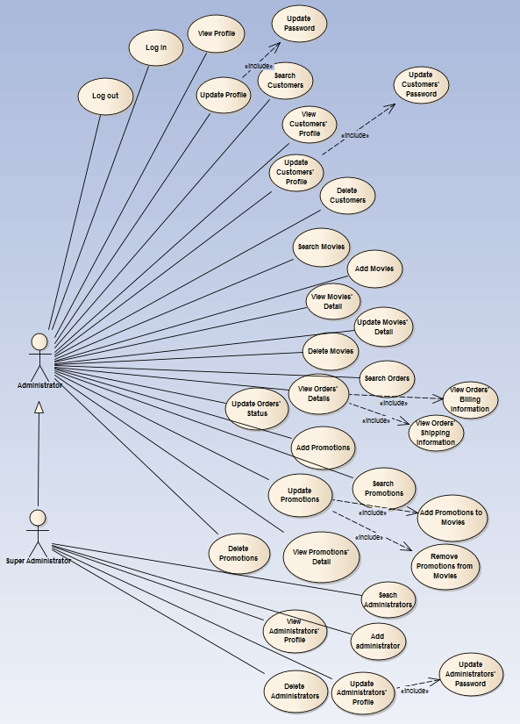
Requirements
User Cases of Administrator
Notes:
Here is the User case diagram of Administrator.
Administrator can ……..
Super administrator is specialized from administrator. It can manage normal administrator. Such as adding administrator, deleting administrator and so on.

Slide 15
Requirements
System Requirement
Python, HTML, CSS, JavaScript, SQL, XML
Django, Scrapy, Jquery, AJAX
Eclipse, MySQL Workbench MongoDB
Notes:
The programming language I used is Python.
Django is a MVC framework for python.
Scrapy is a web spider.
I will talk about them later.

Slide 16
Design
Architecture Design
Detailed Design
Database Design
GUI Design
Notes:
In this section, I will talk about the design of this project, including architecture design, detailed design, database design and GUI design.

Slide 17
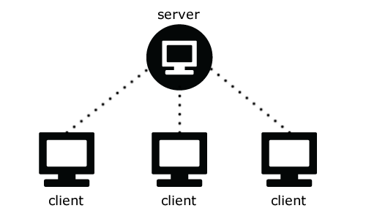
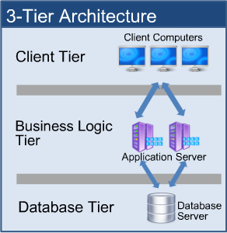
Architecture Design –High Level
Client/Server Model
Notes:
Here is high level architecture design. The project is a practice of Client/Server models. The client-server model is a distributed application structure that partitions tasks or workloads between the providers of a resource or service and service requesters. The provider of service is called server and the requester is called clients.
The client-server model is a approach of 3-tier architecture. They are Client tier or presentation tier, business logic tier and database. In Client-server model server is construction of logic and database tier. And Client is responsible for representation.
In my project

Slide 18
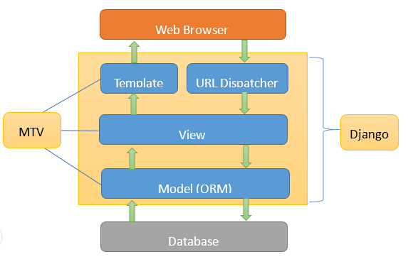
Architecture Design – Lower Level
Django & MTV
Notes:
Here is the lower level design. Django is a model-view-controller framework for python.
As it shown above, they are three main component of Django frameworks.
They are template, view and Model. MTV is the abbreviation of them.
The model defines the data in Python and interacts with it. The model in Django is a practice of Object-relational mapping (ORM) model. It will automatically map the model classes to tables in the database and provide encapsulated methods which are easy to understand and use. So programmer can be free from writing SQLs.
The view function performs the requested action from web browser which typically involves reading or writing to the database.
The templates typically return HTML pages to Browser.
I have make an improvement to MTV models. I will give more details in the section of implementation.

Slide 19
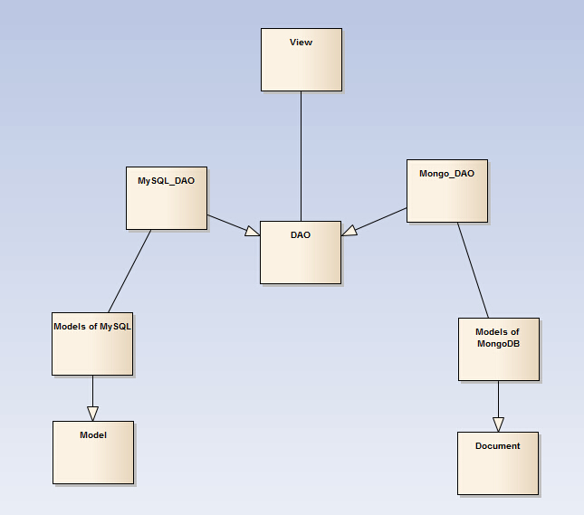
Detailed Design
Class Diagram
Notes:
Here is the class diagram.
The view class is a collection of logic controlling function.
DAO stands for Data Access Object. IT’s a super class of MySQL_Dao and Mongo_DAO. They are responsible for database querying.
MySQL_Models and MongoDB_Modles are sets of models which are sub classes of Model and Document.
Model and Document are system lib classes in Django

Slide 20
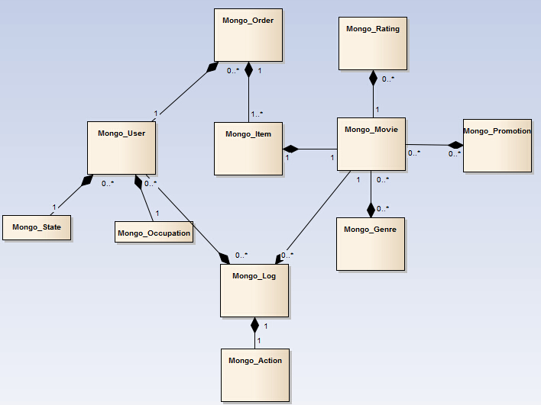
Detailed Design
Class Diagram for MongoDB_Models
Notes:
Here is classes of MongoDB_Models. If gives a brief look of relations between model classes. It’s similar to ER Diagram. This is because of the ORM model. Each class here will map a table in database.
The Mongo_log will record the activities of user. Mongo_User, Mongo_Movie, Mongo_Action are 3 attributes of this class. Who does what to what.

Slide 21
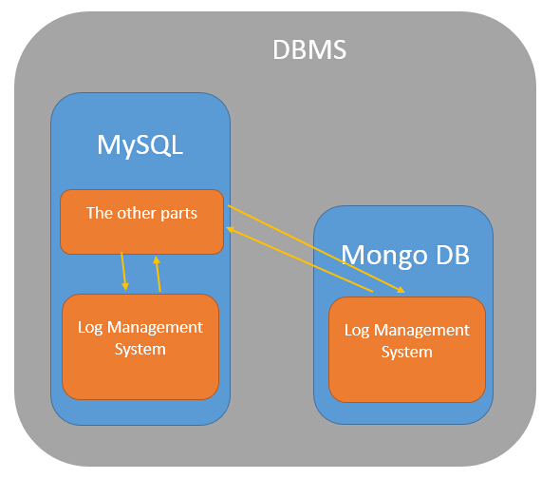
Database Design
Database Design – Previously
Notes:
I have 2 database design. In both designs the database is divided into two parts. Log management system and the other parts.
Let’s take a look at the ER diagram. It give us a brief look of these two parts.
What is Log management system?
What is the other parts?
Pure MySQL
Hybird Database
why do I separate the tables of log management system from the other parts
One reason can be found in life cycle model
The reason why I separate the log management system and leave the rest parts of database the same is that the data in log management system is supposed be much massive then the other parts.
For example, if I wan to testing the performance of the database of 100millions rows, the log table is the only one that can reach that size.

Slide 22
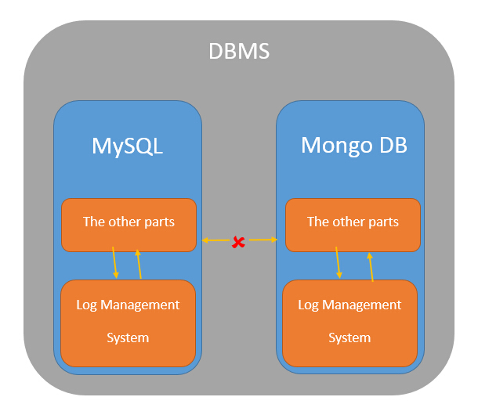
Database Design
Database Design – Currently
Notes:
Pure MySQL and Pure MongoDB
No communication
Let’s compare the current design with previous one. The previous design reduce the time of redesigning the table of the other parts. It seems to be better than current one. However, the real practice is not as good as expected.
There are 5 reason that I give up the previous design and choose the current one.
Firstly, since the log management system is separated. The system have to connect two databases which are totally different at same time. The time cost to connect to the database will be double and the risk of database connection fails will increase.
Secondly, the data format of MySQL and Mongo DB are different. It cost a lot to transforming data type.
Thirdly, it’s very hard to maintain or back up the data.
Fourthly, no matter which kinds of database is more efficient, it always has to wait for the database with lower speed finishing transaction before moving on.
At last, it’s hard to conduct performance testing.
For example, if the test result shows the hybrid database is slow than the pure mysql, you can’t tell the reason.

Slide 23
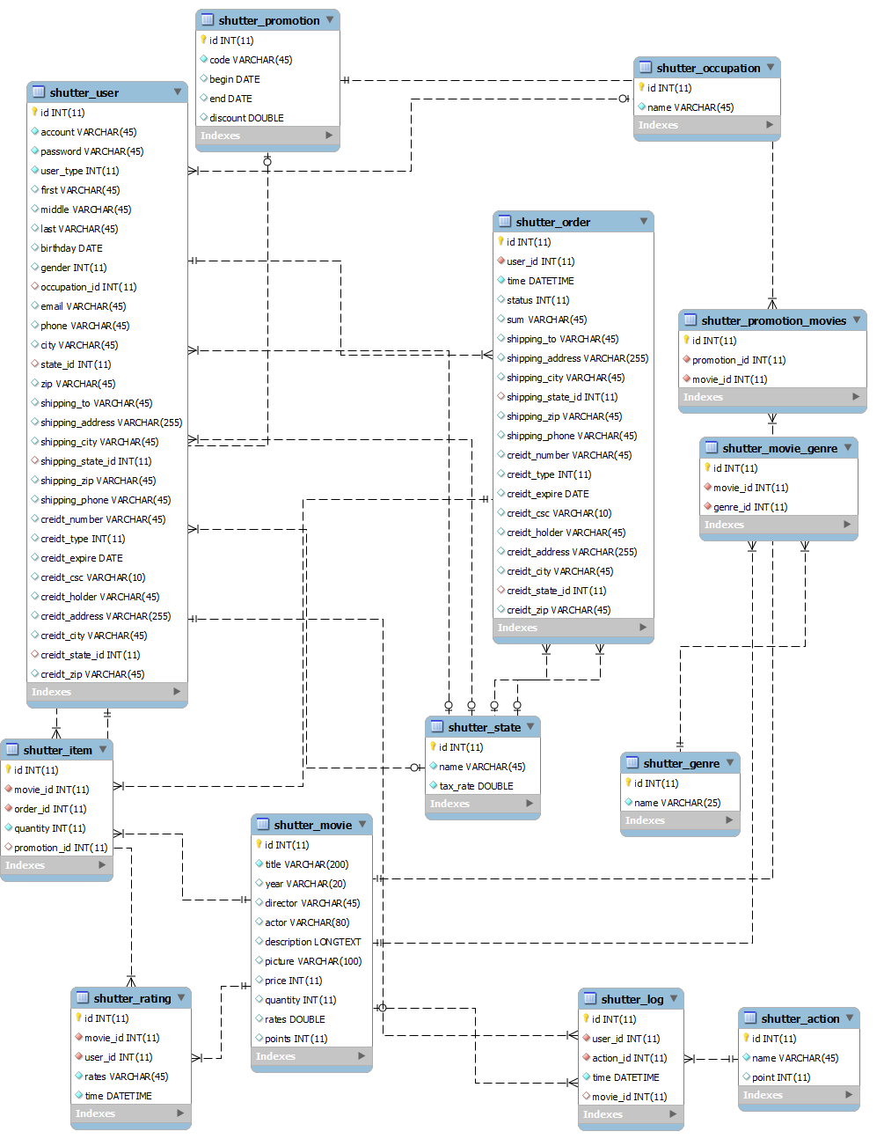
Database Design
ER Diagram

Slide 24
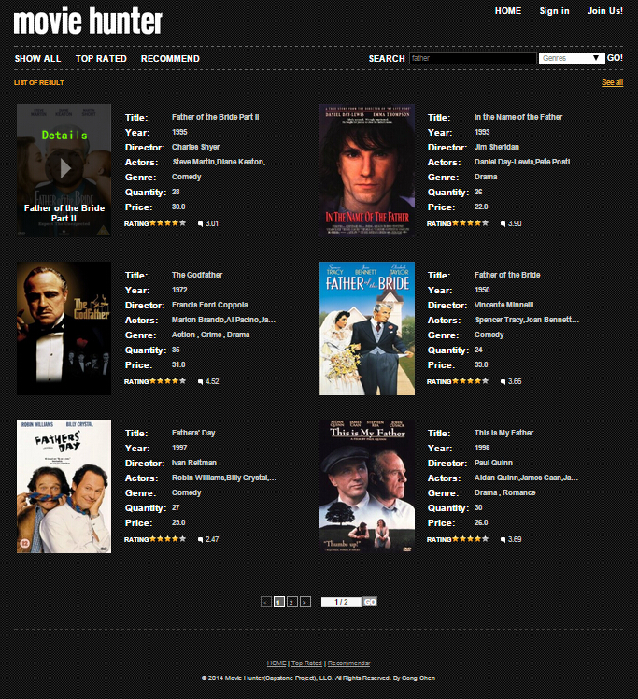
GUI Design
Notes:
Concision and easy to use are the brief idea of my GUI design
I believen the less the cooler. Since movie hunter is design for general public, I try to make the GUI as concise as possible. I use a lot of navigation component, such as tags and links, and avoid trivial texts.
The height of all pages will be no more than two scrolls. This will keep all the information one screen shot. Users will be free from scrolling top and down to find what they need.

Slide 25
Implementation
Technique Used
Implementation of Log Management System
Implementation of Recommendation System
Obtain Data

Slide 26
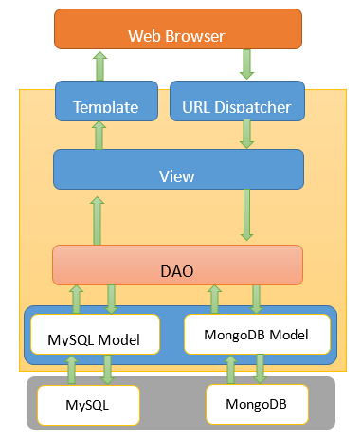
Improvement of MTV
Notes:
since Movie Hunter is a project built on multiple database resources. I improve the MTV to make it fit the requirement better.
In the original MTV design, view directly access the database. Because there are two sets of models, MySQL Model and Mongo DB Models, which are associated with two different databases, the result query from different database will be different. So the View tier has to validate the result and transform it to a standard format. It will give a lot pressure to View and bring a lot of repeated to source code.
I add a ADO tier between view and model. The main work of DAO is to provide standard database query functions which will contains standard input and output no matter what databases it connect to.
Therefore, View tier can do logic functions without validating and transforming input and output of querying. This will not only reduce a lot of workload of coding but also make it much more convenient to debug and maintain the project.

Slide 27
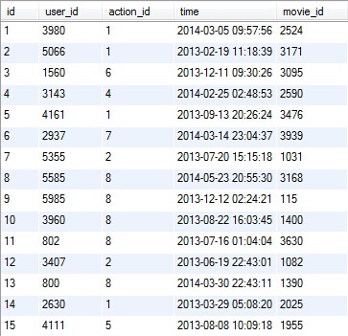
Implementation of Log Management System
ID | Action | Description | Points
1 | Search | A customer search for a movie | 1
2 | Rating 1 | A customer rate a movie by 1 point | -1
3 | Rating 2 | A customer rate a movie by 2 point | 0
4 | Rating 3 | A customer rate a movie by 3 point | 1
5 | Rating 4 | A customer rate a movie by 4 point | 2
6 | Rating 5 | A customer rate a movie by 5 point | 3
7 | View Details | A customer browse the details of a movie | 2
8 | Make an order | A customer add a movie to his/her shopping cart | 3
Notes:
The left table is the list of predefined actions.
If a customer makes any of these actions, it will be record in log table.
The right table is a chunk of data in log table.
For example, the first row in the figure means that a user whose id is 3980 search a movie of which id is 2524 at 2014-03-05 09:57:56.

Slide 28
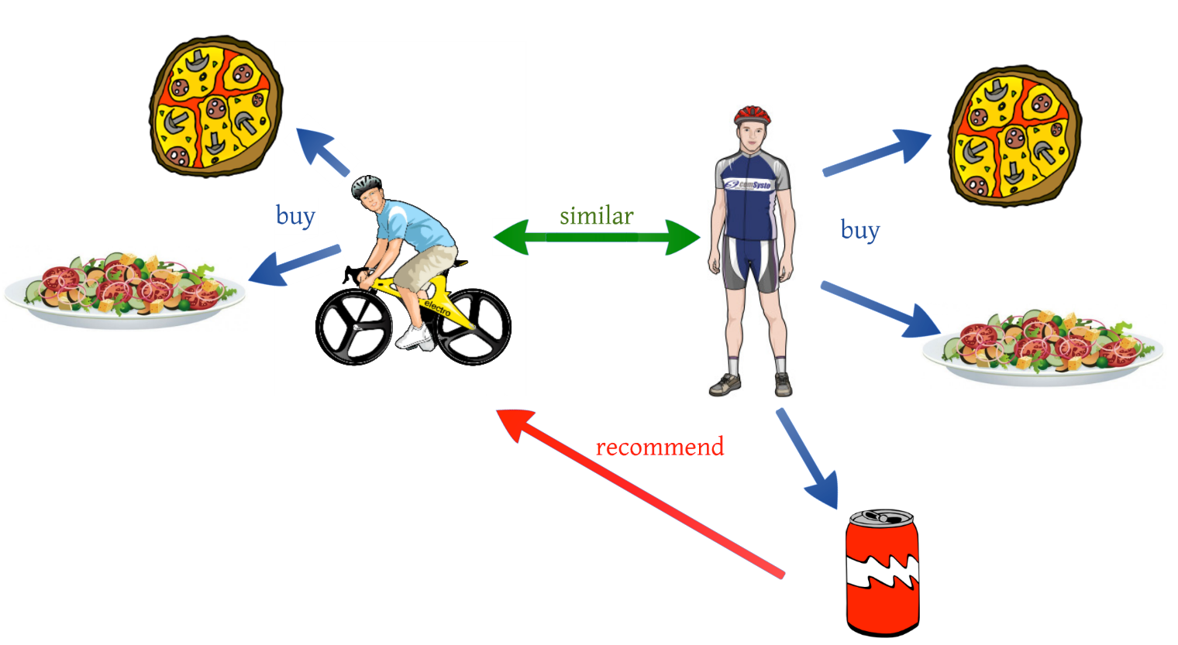
Implementation of Recommendation System
Collaborative Filtering
Collaborative filtering methods are based on collecting and analyzing a large amount of information on users’ behaviors, activities or preferences and predicting what users will like based on their similarity to other users
Notes:
For example, if user A like an item B, other users

Slide 29
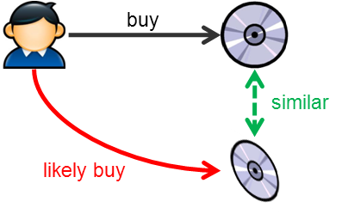
Implementation of Recommendation System
Content-based filtering
Content-based filtering methods are based on a description of the item and a profile of the users’ preference
Notes:
I choose content-based filtering. Because it fit my system well.
The genre of movies is a good the description of item.
The log can shows the preference of user.

Slide 30
Implementation of recommendation System
Four steps of generating a recommend list
1. Get the most recent logs of the user
2. Score genres based on logs
3. Score movies based on the scores of genres
4. Recommend the movies based on the scores of movies

Slide 31
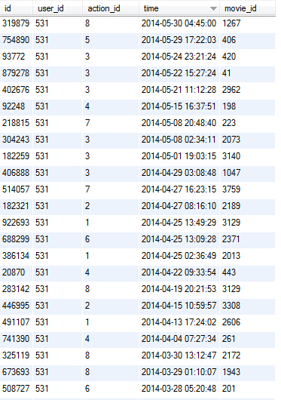
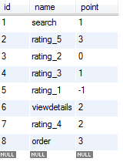
2.Score Genres Based on Logs
Genre | Point
Action | 0
Adventure | 0
Animation | 0
Children`s | 0
Comedy | 0
Crime | 0
Documentary | 0
Drama | 0
Fantasy | 0
Film-Noir | 0
Horror | 0
Musical | 0
Mystery | 0
Romance | 0
Sci-Fi | 0
Thriller | 0
War | 0
Western | 0
Genre | Point
Action | 25
Adventure | 3
Animation | 15
Children`s | 28
Comedy | 16
Crime | 7
Documentary | 40
Drama | 15
Fantasy | 17
Film-Noir | 12
Horror | 20
Musical | 13
Mystery | 2
Romance | -5
Sci-Fi | 16
Thriller | 17
War | 50
Western | 16

Slide 32
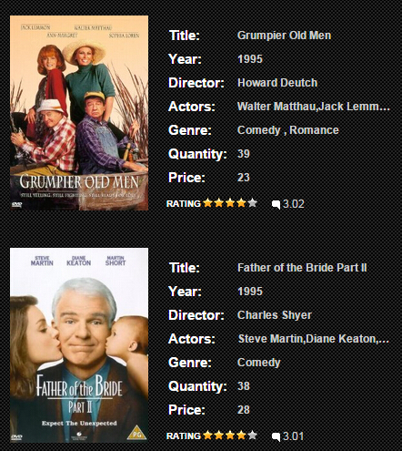
3.Score Movies Based on the Score of Genres
Genre | Point
Action | 25
Adventure | 3
Animation | 15
Children`s | 28
Comedy | 16
Crime | 7
Documentary | 40
Drama | 15
Fantasy | 17
Film-Noir | 12
Horror | 20
Musical | 13
Mystery | 2
Romance | -5
Sci-Fi | 16
Thriller | 17
War | 50
Western | 16
Movie | Points
Grumpier Old Men | 11
Father of the Bride Part II | 16

Slide 33
Obtaining Data
Three Ways to Obtain Data
1. From a third party
2. Scrapy
Scrapy is a web crawling framework with support for web craping.
3. Data generator

Slide 34
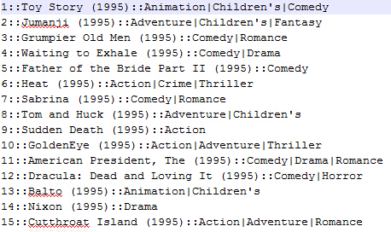
From a Third Party
Grouplens provide several open data sources. MovieLens is one of them. I analyzed the data format in MovieLens, validate and transformed it to fit my database design.

Slide 35
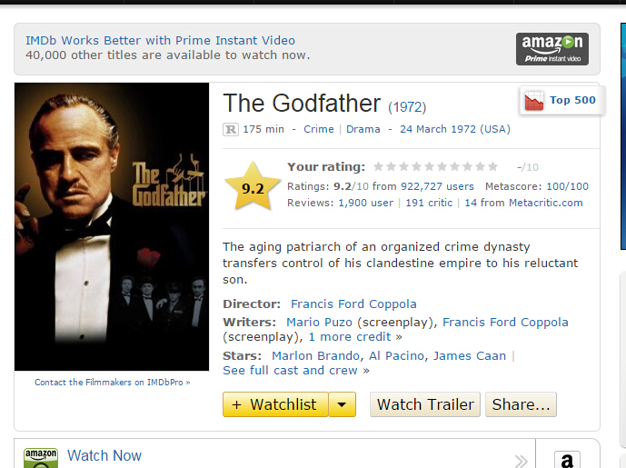
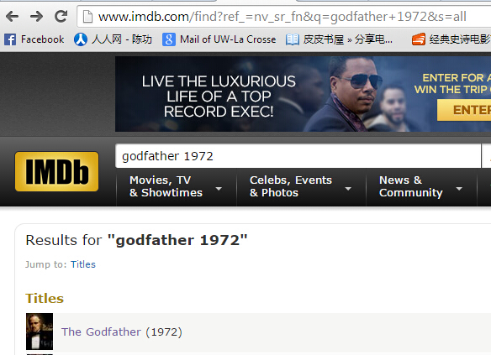
Scrapy
1. Analysis the Web You are going to Crawl.

Slide 36
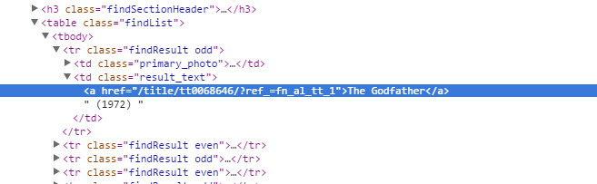
Scrapy
2. Use Scrapy to Get the XML file of Page

Slide 37
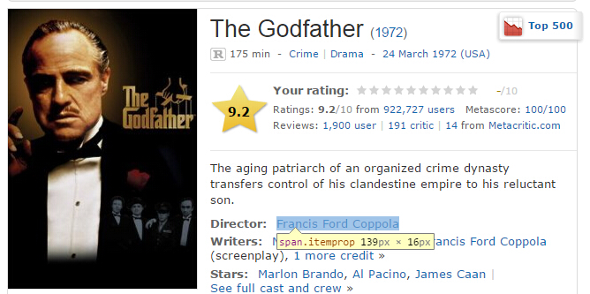
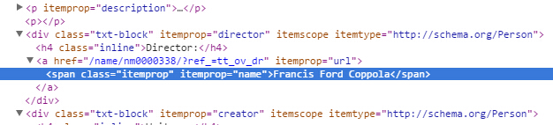
Scrapy
2. Use Scrapy to Get the XML file of Page

Slide 38
Scrapy
3. Use Select Method Provide by Scrapy to Extract Data
In : hxs.path('//itemprop/text()').extract()
Out: [u'Francis Ford Coppola']

Slide 39
Data Generator
The main work of data generator is to generator data for log table
In this system, I generate 3 sets of log table the size of which are 1M, 10M and 100M

Slide 40
Testing
Validation and Testing
Database Performance Testing

Slide 41
Testing
Testing Case
Test objectives | User can log in normally
Steps | Open the client program to enter the login screen, press to enter the correct username and password, click “log in”, see if you can successfully log in and view return. Enter incomplete or incorrect login information, click login to view return.
Expected | In the first test, the user is able to log in successfully In the second test, the user cannot login successfully
Per-condition | True
Result | Passed
Notes:
The testing follow the typical incremental approach. First, Each new component added to the system will be tested separated. Then I will add it to the whole system and do interate testing.

Slide 42
Testing
Performance Testing
Testing Results of Inserting
Database | Operation | No. of Rows Inserted | Run Time (ms)
Mongo | Insert | 1,000,000 | 42102
MySQL | Insert | 1,000,000 | 104049
Mongo | Insert | 10,000,000 | 411121
MySQL | Insert | 10,000,000 | 1130493
Mongo | Insert | 100,000,000 | 4141528
MySQL | Insert | 100,000,000 | 11135474
Notes:
The inserting speed of Mongo DB is as good as 2 – 3 times of MySQL

Slide 43
Testing
Performance Testing
Testing Results of Selecting
Database | Operation | Total Rows | No. of Rows Selected | Run Time (ms)
Mongo | Select | 1,000,000 | 5000 | 5248
MySQL | Select | 1,000,000 | 5000 | 523
Mongo | Select | 1,000,000 | 50000 | 5428
MySQL | Select | 1,000,000 | 50000 | 593
Mongo | Select | 10,000,000 | 5000 | 17411
MySQL | Select | 10,000,000 | 5000 | 5836
Mongo | Select | 10,000,000 | 50000 | 13049
MySQL | Select | 10,000,000 | 50000 | 6128
Mongo | Select | 100,000,000 | 5000 | 92985
MySQL | Select | 100,000,000 | 5000 | 162805
Mongo | Select | 100,000,000 | 50000 | 95594
MySQL | Select | 100,000,000 | 50000 | 164630
Notes:
the reading speed of MySQL is as good as 2 – 10 times of Mongo DB.

Slide 44
Conclusions
According to the performance testing of MySQL and Mongo DB, we can find out that there is no conclusions which is better. NoSQL and SQL database both have their advantage and disadvantage.
Notes:
MySQL and Mongo DB are like 2 warehouse.

Slide 45
My Guess
The data structural cause the difference. The data structural in MySQL is more strict than Mongo DB. So when you insert a new record. MySQL spends more time on it. However, because of the more precise data structural, MySQL is more efficient on selecting.
Notes:
You can treat MySQL and Mongo DB as 2 big warehouse. When you put new things to MySQL, you have to store it right and neat. When you store new things to Mongo DB, you can put it anywhere you want. So mongo DB might save a lot of time when storing things.
On the hand when you try to find something in MySQL, It is much easier because the things in MySQL is put in good order.

Slide 46
Demo
Customer
Register
Login and Logout
Find back password
Purchase movies
Show the recommendation after the actions above.

Slide 47
Demo
Administrator
Add a new administrator
Associated a movie with the new promotion

Slide 48
Questions?

